Slide 1
Osher Lifelong Learning Institute, June 2026
The Economics of Public Policy Issues
University Of Minnesota
Host: Geoffrey Woglom, Director
National Economic Education Delegation

Slide 2
National Economic Education Delegation
Vision
  One day, the public discussion of policy issues will be grounded in an accurate perception of the underlying economic principles and data.
Mission
  NEED unites the skills and knowledge of a vast network of professional economists to promote understanding of the economics of policy issues in the United States.
NEED Presentations
  Are nonpartisan and intended to reflect the consensus of the economics profession.

Slide 3
Who Are We?
Honorary Board: 54 members
  2 Fed Chairs: Janet Yellen, Ben Bernanke
  6 Chairs Council of Economic Advisers
    Furman (D), Rosen (R), Bernanke (R), Yellen (D), Tyson (D), Goolsbee (D)
  3 Nobel Prize Winners
    Akerlof, Smith, Maskin
Delegates: 652+ members
  At all levels of academia and some in government service
  All have a Ph.D. in economics
  Crowdsource slide decks
  Give presentations
Global Partners: 48 Ph.D. Economists
  Aid in slide deck development

Slide 4
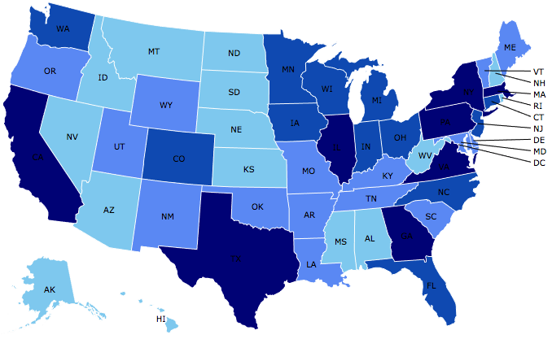
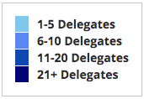
Where Are We?

Slide 5
Available NEED Topics Include:
US Economy
Healthcare Economics
Climate Change
Economic Inequality
Economic Mobility
Trade and Globalization
Minimum Wages
Immigration Economics
Housing Policy
Federal Budgets
Federal Debt
Black-White Wealth Gap
Autonomous Vehicles
US Social Policy

Slide 6
Course Schedule
Contemporary Economic Policy
  Week 1 (10/8): Economic Update & Changes at the Fed, Geoffrey Woglom, Amherst College
  Week 2 (10/15): Climate Change Economics, Galina Hale, UC Santa Cruz
  Week 3 (10/22): The Future of Money, Geoffrey Woglom, Amherst College
  Week 4 (10/29): The Economics of Tariffs, Tibor Besedes, Georgia Institute of Technology
  Week 5 (11/5): Economics of Immigration, Roger White, Whittier College
  Week 6 (11/12): TBD

Slide 7
Submitting Questions
I encourage questions. Please put questions in the chat and I will answer them periodically during the talk,
We will do a verbal Q&A once the material has been presented.
Slides are available from the NEED website https://needecon.org/delivered_presentations.php.

Slide 8
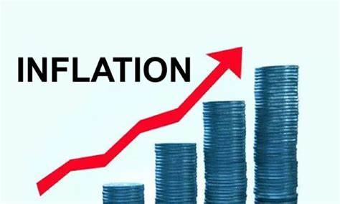

US Economy: Update
&
The Recent Rise in Interest Rates
Geoffrey Woglom,
Professor of Economics
Amherst College, emeritus
October 8, 2026

Slide 9
Outline for the Talk
Part 1
Overview of State of the Economy: Remarkable resilience in the face of wars, oil prices & tariffs, but worrying signs.
Major uncertainties going forward.
Part 2
The Runup in World Wide Interest Rates.
Why This is Important.
How to Read the Message in Rising Interest Rates

Slide 10
Judging the State of the Macroeconomy
The Fed’s Definition:
Get the economy to the highest levels of output (GDP) and employment, while
Keeping inflation low and stable, or at 2%
What about the climate change; poverty, health care?

Slide 11
Gross Domestic Product: 2026Q2 = $32.6 tr
$33.4
Less Imports
-$4.7
Plus Exports
+$3.8
Equals GDP
$32.6

Slide 12
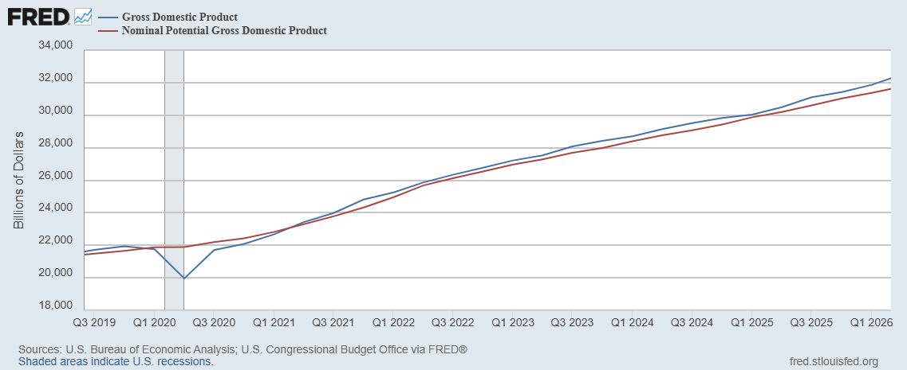
GDP and ‘Potential’ during the Recovery
Grey bar indicates recessions
Source: Fred, St Louis Fed

Slide 13
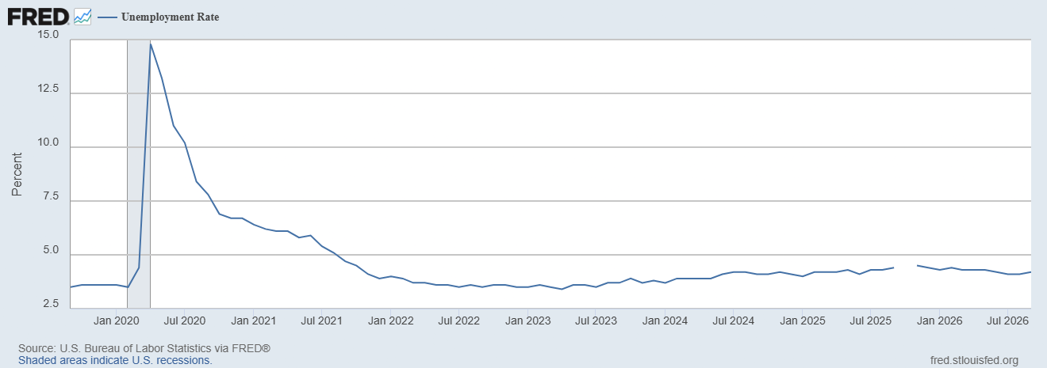
Unemployment is Near Record Lows

Slide 14
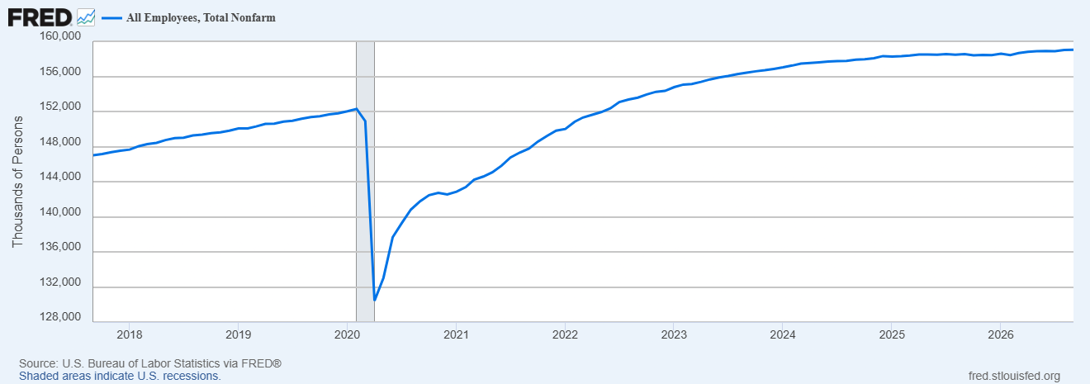
Where Have All the Workers Gone?
Aging of the Labor Force
Also, note the recent slowing in job growth.
Source: Fred, St Louis Fed

Slide 15
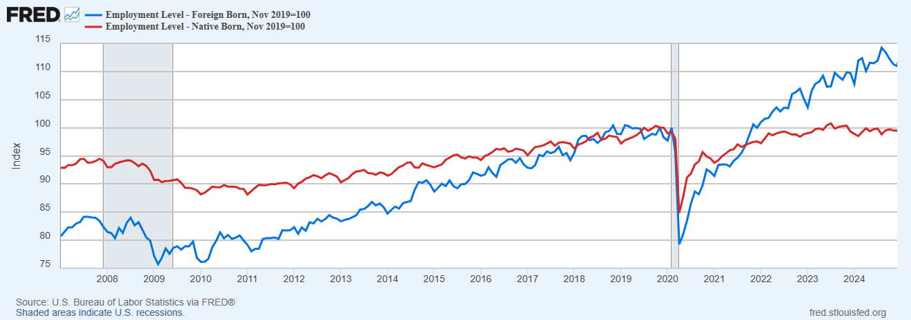
Could Have Been Worse , but for Foreign Born Workers
Between 12/19 and 4/25
NB employment flat
FB employment rose by 5000k
Since 4/25 FB employment
fell by 1000k; NB constant

Slide 16
BLS September Jobs Surprise (?)
Notes:
Response rate: Precovid in the 70s, now below 30

Slide 17
The Real Side of the Economy is Still Good
GDP is very close to its potential.
The labor market as measured by the unemployment rate is fully recovered.
Macro Goal number 1, check
But what about goal number 2, the “nominal” side of the economy

Slide 18
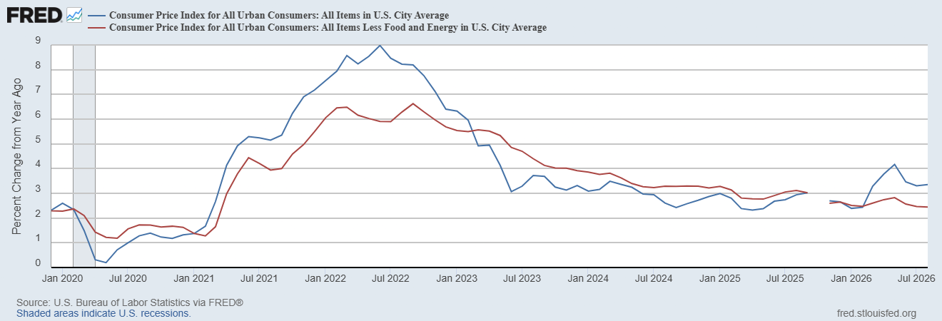
Inflation during the Recovery (CPI)
Notes:
August CPI yoy 8.3% down from 8.5 and Core 6.3 up from 6.3 in JUly

Slide 19
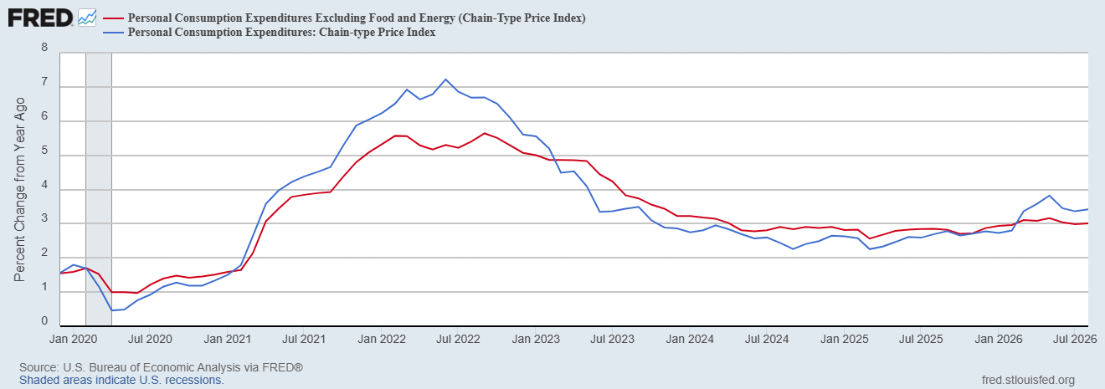
Fed’s Measure (PCE)
Inflation Accelerates 3/2021
Fed Doesn’t React until 3/2022
Progress towards the 2 % slows Spring 2024

Slide 20
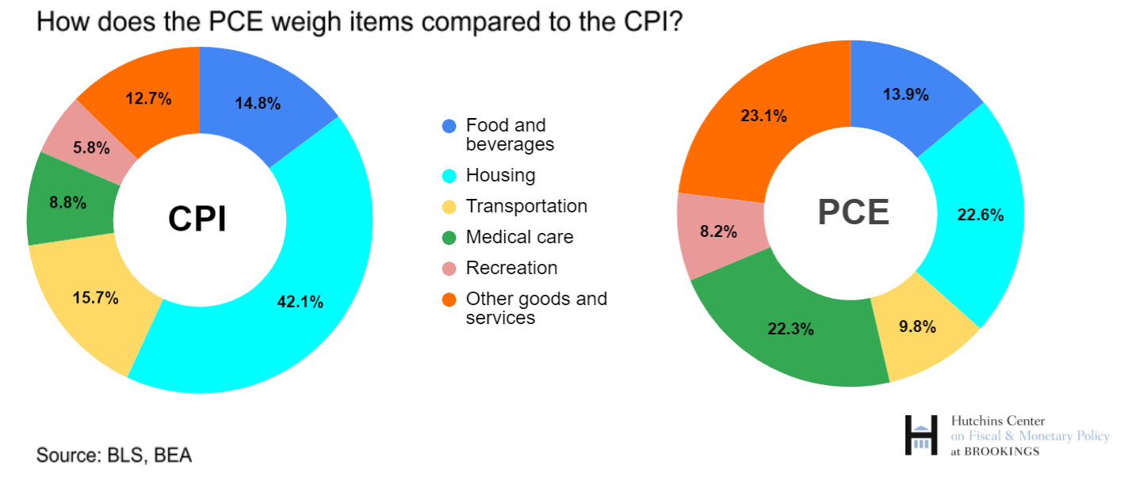
CPI vs. PCE: Differences
CPI typically tends to be 0.3 pct point higher
Aug:
CPI, 3.4%
PCE, 3.4%
Core CPI, 2.4%
Core PCE, 3.0%.
https://www.brookings.edu/articles/how-does-the-government-measure-inflation/

Slide 21
“Affordability”
Notes:
136 129 130 126 118

Slide 22
Three Measures of Cost of Housing Inflation
Notes:
87,32,30

Slide 23
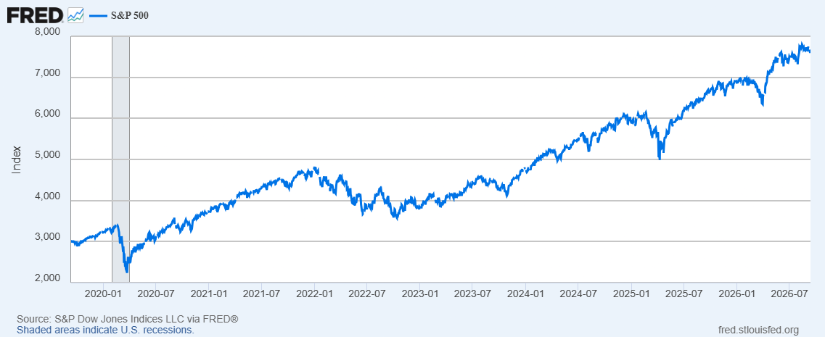
Stock Prices: Tariffs, What Tariffs; War, What War?
Notes:
Since the end of 2021, lost almost 15%

Slide 24
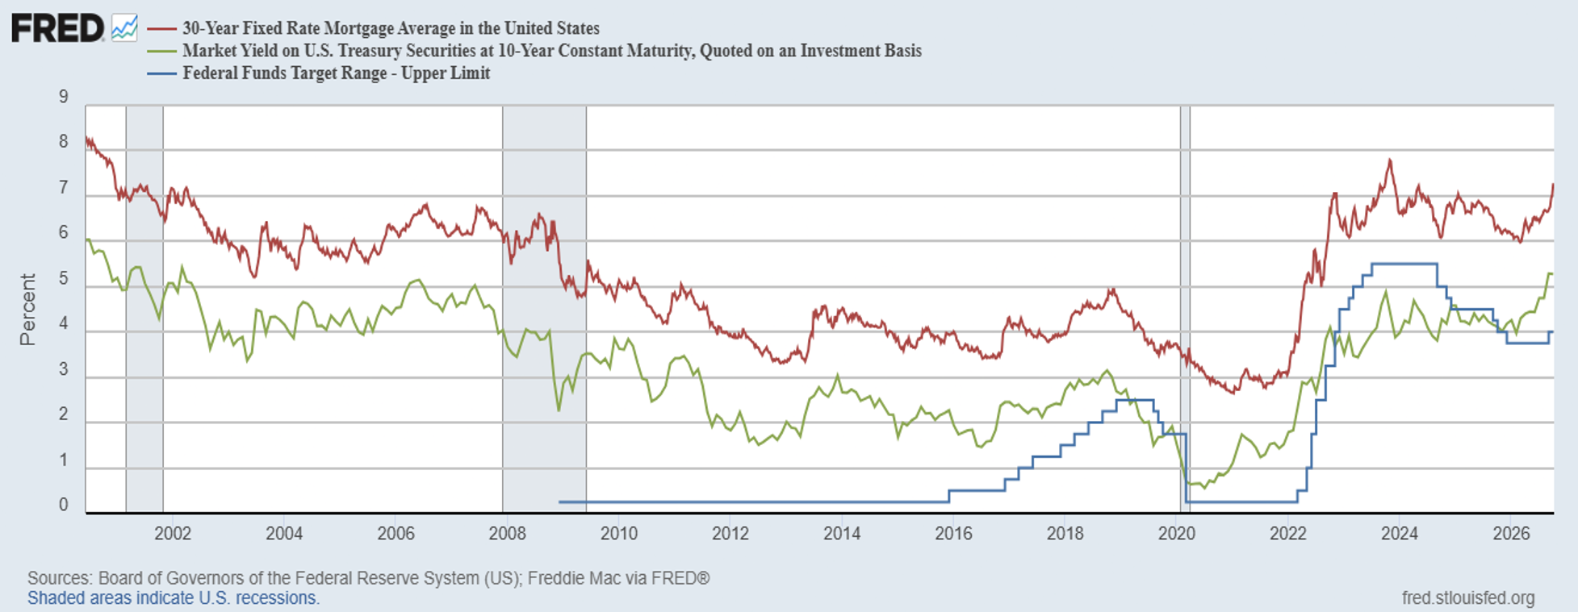
Interest Rates: Era of Falling Rates Over?
Notes:
3 Things: 1.

Slide 25
The State of the Economy & the Future
The key indicators for judging the macro economy are still good
  Output and unemployment are close to their “full employment” levels,.
  Inflation is still elevated, but some of this is due to “price shocks.”
Concerns
  K-shaped growth.
  Is the AI boom sustainable?
  Price shocks may get worse due to war in Iran.

Slide 26
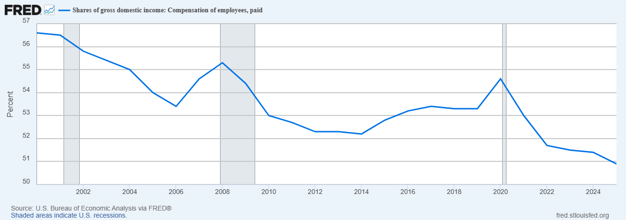
Labor’s Share of Income is Falling

Slide 27
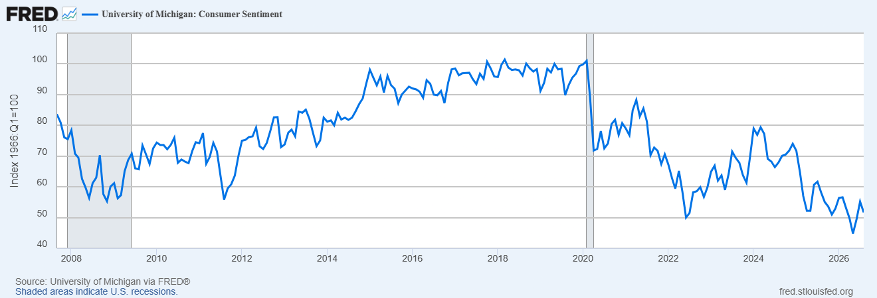
Consumers Are Very Pessimistic

Slide 28
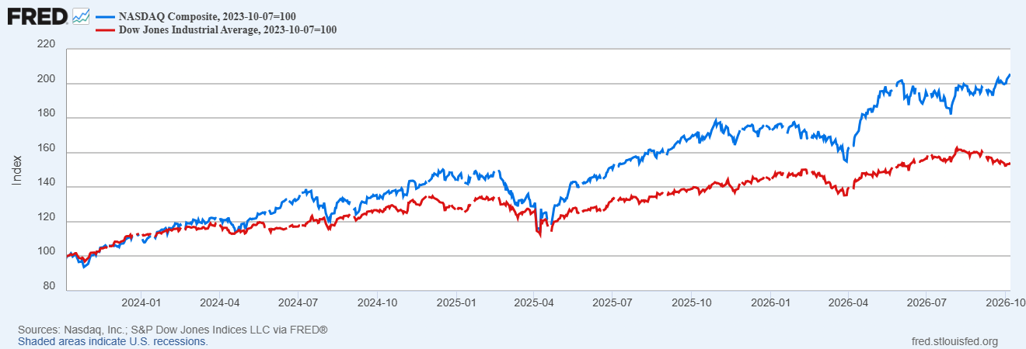
The Stock Market is Being Driven by Tech

Slide 29
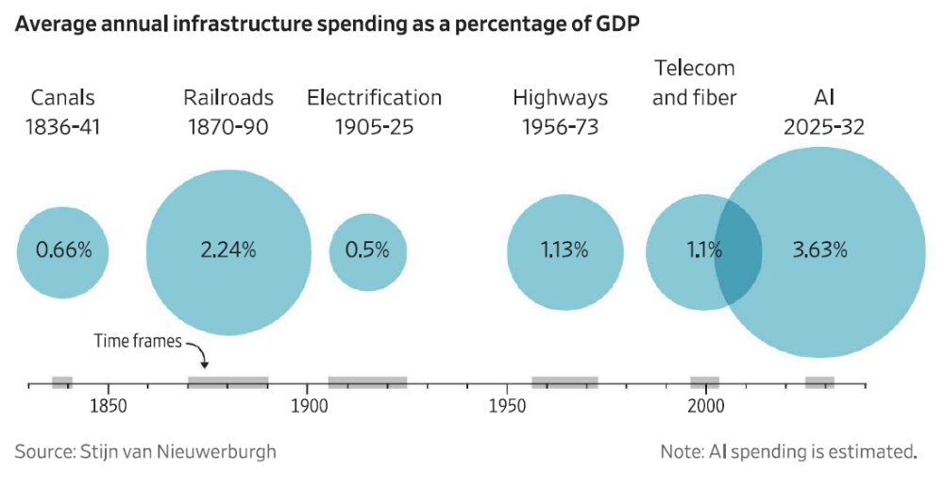
AI Boom is Unprecedented
https://www.brookings.edu/wp-content/uploads/2026/09/4c_Van-Nieuwerburgh.pdf

Slide 30
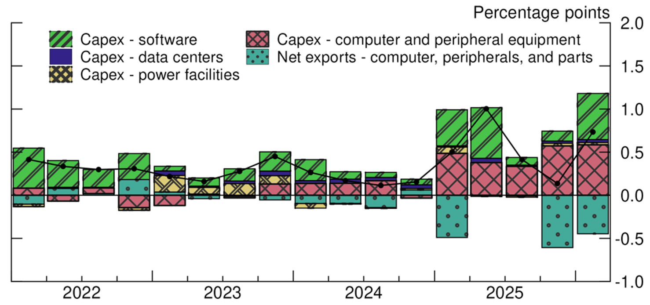
AI’s Contribution to Growth
https://www.federalreserve.gov/econres/notes/feds-notes/the-ai-buildout-and-the-economy-publicly-available-data-to-assess-ais-impact-20260717.html

Slide 31
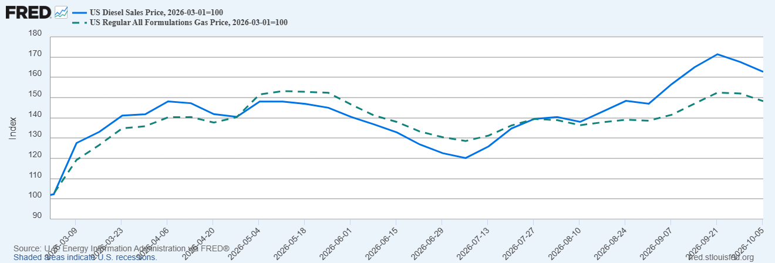
The Rise in Diesel is Bigger & More Inflationary

Slide 32
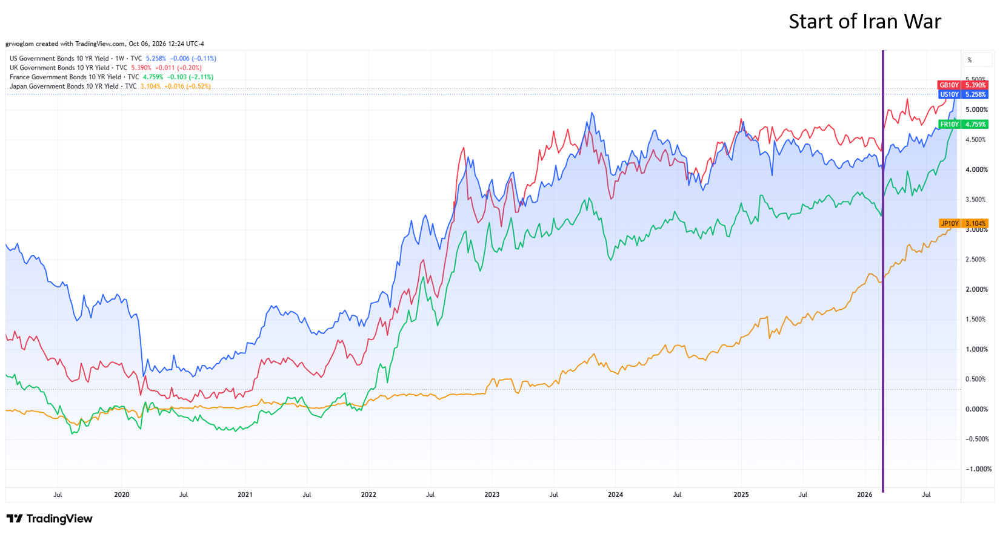
Part 2 Intro: The World Wide Rise in Rates

Slide 33
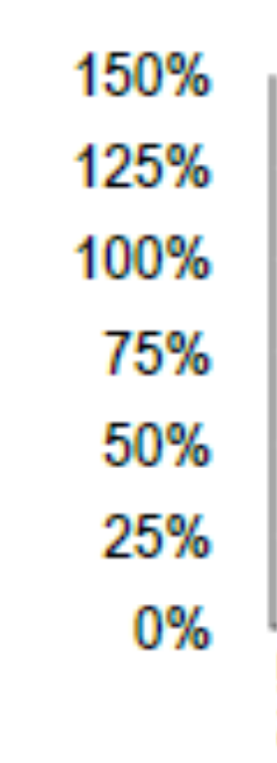
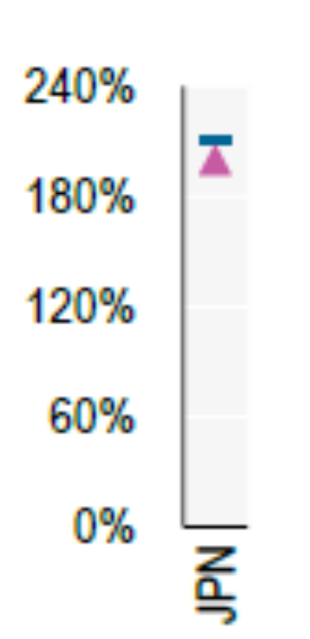
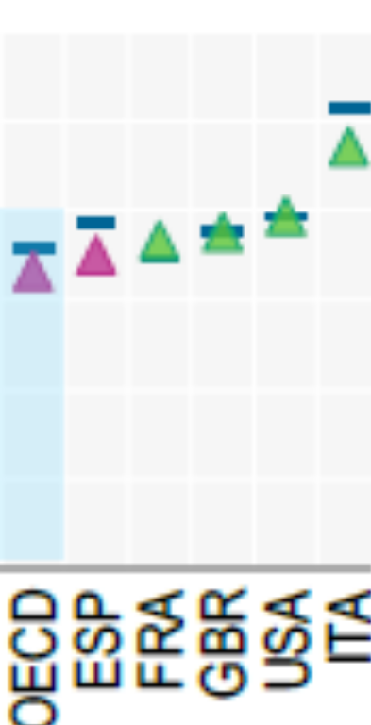
Why Do High Interest Rates Matter?
2025 Levels of Debt to GDP
Effects of 1 pcp increase in interest rates on CBO projections for 2056.
Debt-to-GDP ratio rises from 175% to 222%.
Deficit rises from 9.1% to 14% of GDP.
Interest on the debt rises from 6.9% to 11.4%,at which point it would comprise 60% of total federal revenue.
OECD (2026), Global Debt Report 2026: Sustaining Debt Market Resilience Under Growing Pressure, OECD Publishing, Paris, https://doi.org/10.1787/e9d80efd-en.
Notes:
Fiscal Sustainability

Slide 34
Why Do High Interest Rates Matter2?
Housing shortage and housing affordability.
WSJ, 10/5 headline: The Surge in Rates is Blowing Up Commercial Real-Estate Deals.
WSJ, 10/8 headline: Rising Rates are Eroding the Value of Even the Most High-Flying Tech Stocks
The Stock Market
https://shillerdata.com/

Slide 35
Key Questions
What Caused the Increase?
Are High Rates Likely to Persist?
Reading the Tea Leaves from various Interest Rates will help us to answer these questions.

Slide 36
Outine for Part 2
Explain the difference between nominal or stated interest rates and the real rate.
The Fed determines nominal short-term interest rates.
The relationship between short-term and long-term interest rates
Conclusion from the tea leaves.

Slide 37
Results from Reading the Tea Leaves.
The vast majority of the increase in interest rates was due to increases in the real rate.
Some shorter-term bonds have risen in anticipation of the Fed raising the federal funds rate.
The rise in the rate on the longest-term bonds implies higher rates are expected to persist because of higher real rates, not higher inflation.

Slide 38
Nominal and Real Interest Rates
The stated or nominal interest rate is the rate at which your dollars grow.
The real interest rate is the rate at which your purchasing power grows. The real rate is the nominal rate minus expected inflation.
Reading the Tea Leaves by comparing US Bonds to Inflation protected US Bonds (TIPs).

Slide 39
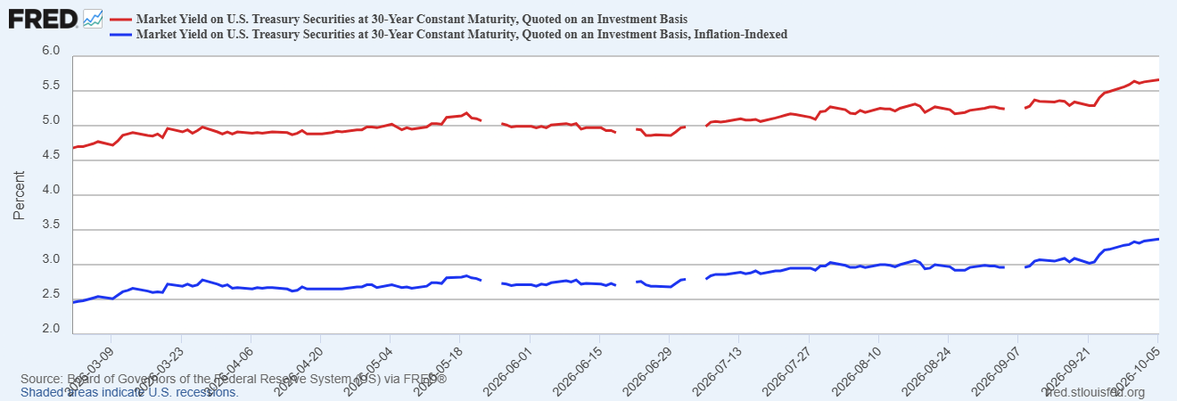
The Rise in Government Bond Interest Rates
Inflation Compensation
=5.66-3.37=
2.29%
Inflation Compensation
=4.7-2.47=
2.23%
Result 1: The vast majority of the increase in the 30-yr rate was due to the increase in the real rate.

Slide 40
The Federal Funds Rate, the Policy Instrument
The federal funds rate is the interest rate charged on overnight loans of bank reserves between two banks.
The Fed sets a target range for the federal funds rate; currently 3.75% to 4.00%.
If the market federal funds rate rises above 4%, the Fed buys government securities which increases the supply of bank reserves.

Slide 41
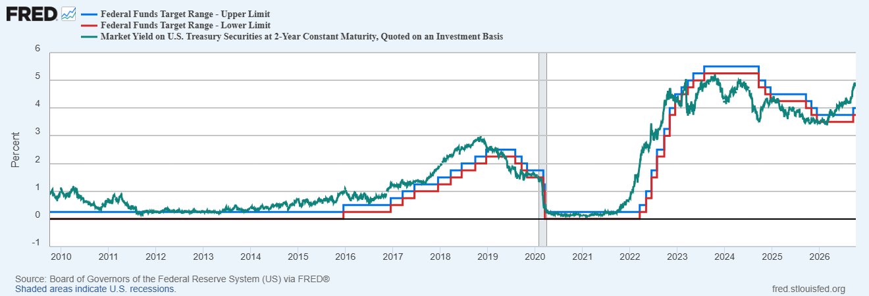
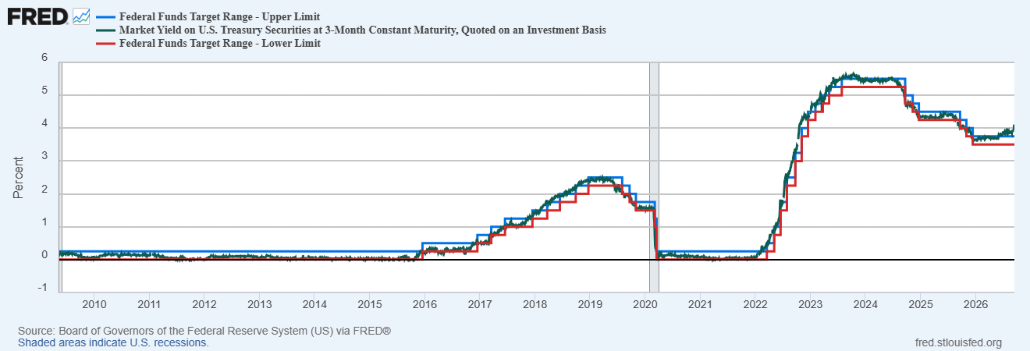
The Fed Essentially Sets the 3-month rate

Slide 42
Interest Rates on Long- and Short-term Bonds
Long-term bond rates can also be decomposed into 2 different components:
  The expected average of short-term rates over the life of the bond
  A term risk premium because the price of long-term bonds is more volatile. than short term.

Slide 43
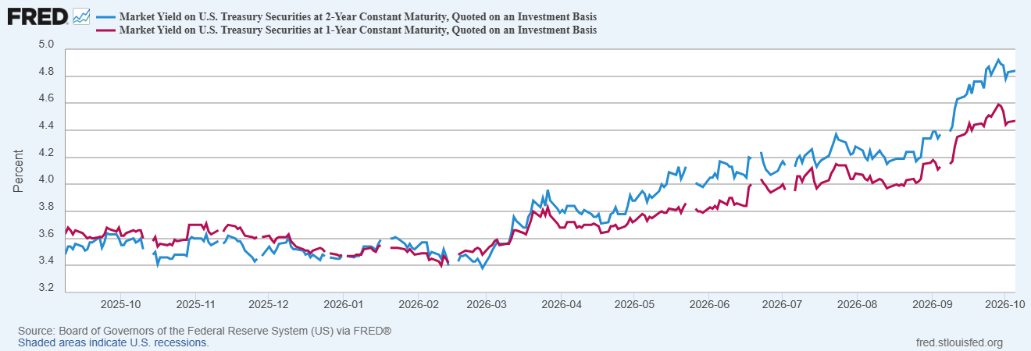
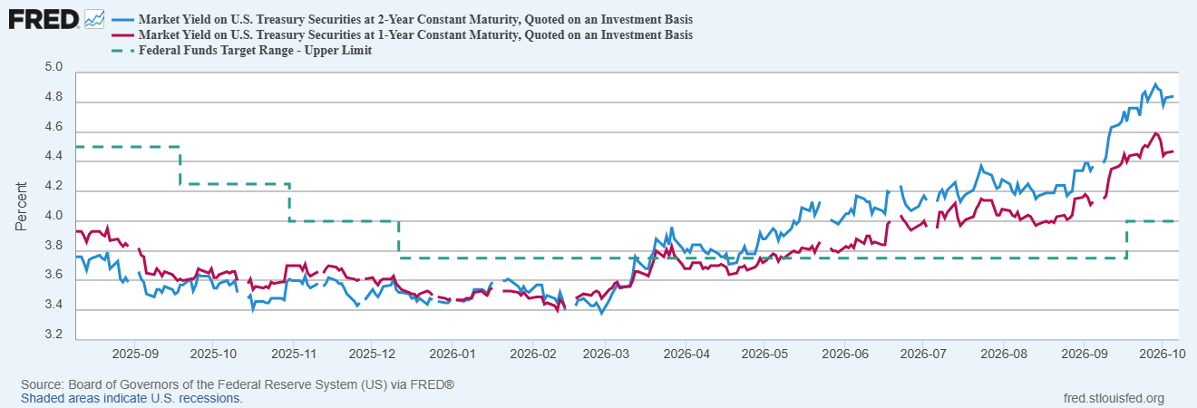
An Example: Interest Rates on 1 &2-yr Bonds
Why has the 2-yr rate risen above the 1-yr rate?
Why would anyone buy a 2-yr bond paying 3.54%, when they could buy a 1-yr bond paying 3.68%
Result2: 2-year rate rose more than the 1-year rate because markets expect the federal funds rate to rise and to be higher for at least 2 years

Slide 44
Story Implied by Changes in Different Maturities
Basic Data:
Tea Leaves:
Result 3: The rise in the real rate on the 30-year bond means that most of the rise in real rates is expected to persist
Maturity | 3/2 nominal | 10/7 nominal | 3/2 real | 10/7 real | 3/2 exp infl | 10/7 exp infl
5 yr | 3.62% | 5.03% | 1.16% | 2.66% | 2.46% | 2.37%
30 yr | 4.70% | 5.67% | 2.47% | 3.36% | 2.23% | 2.31%
Maturity | Change in exp inflation | Change in real rate
5 yr | -0.09 p.c.p | 1.50 p.c.p.
30 yr | 0.08 p.c.p. | 0.89 p.c.p.

Slide 45
Why
First the Good News: The small change in expected inflation implies that the Fed has not lost credibility that it will achieve it long-run goal of 2 percent inflation.
The Bad: Persistently, high real rates are unlikely to be due to the AI investment boom. More likely, credit markets are signaling that US (and many other developed countries) fiscal debt and deficits are not sustainable.
The Worst Case Scenario: A run on the dollar.

Slide 46

A Cheerful (?) Final Note:
The crisis takes a much longer time coming than you think,…
and then it happens much faster than you would have thought.
Rudy Dornbusch

Slide 47
My Google Site
https://sites.google.com/view/macro-current-issues/economic-update

Slide 48

Next: The Atmospheric Greenhouse Effect
Sun
Atmosphere
Energy reflected back
onto earth
Energy reflected back
into space

Slide 49
Let’s Hear from You!
Geoffrey Woglom grwoglom@amherst.edu
Contact NEED: Info@NEEDEcon.org
Support NEED: www.NEEDEcon.org/donate.php

